Slide 1
Switches and Relays
Daniel Kohn
University of Memphis
Department of Engineering Technology
TECH 3821 – Industrial Electronics
Fall 2023

Slide 2
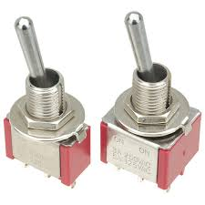
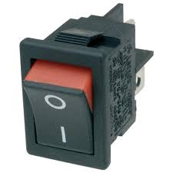
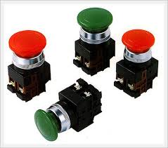
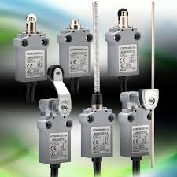
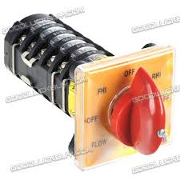
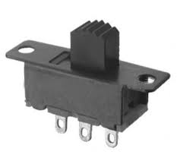
Switches
Definition - a device for making and breaking the connection in an electric circuit.
Types (Action):
Toggle
Rocker
Pushbutton
Limit
Rotary
Slide

Slide 3
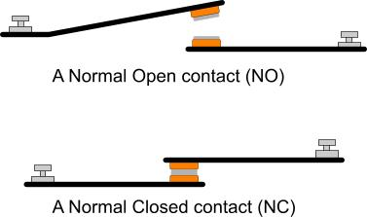
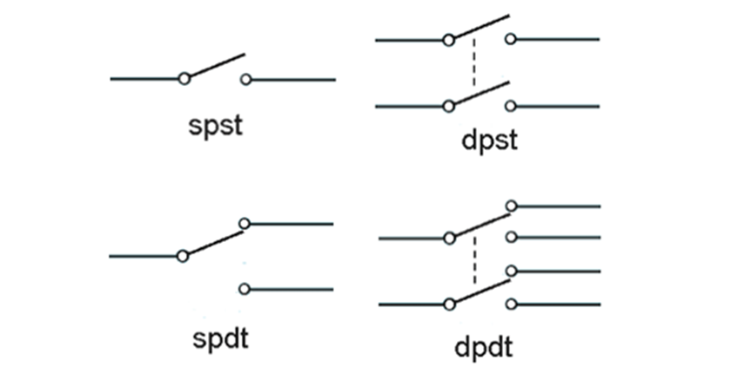
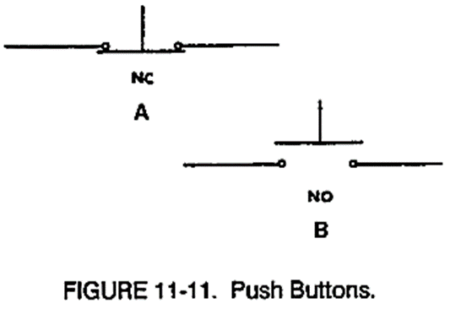
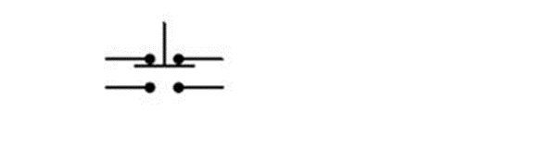
Switches (Cont)
Types (Electronic Connections):

Slide 4
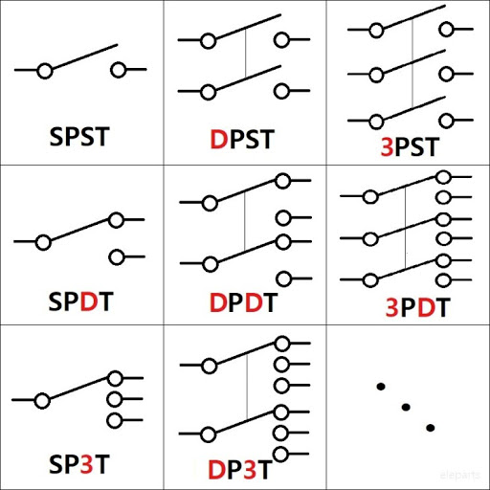
Switches (Cont)
What does SPST, SPDT, DPST, and DPDT mean?
SP and DP refer to single pole and double pole; ST and DT refer to single throw and double throw.
Pole refers to the number of circuits controlled by the switch: SP switches control only one electrical circuit. DP switches control two independent circuits (and act like two identical switches that are mechanically linked). Do not confuse ‘pole’ with ‘terminal’. The DPST switch, for example, has four terminals, but it is a DP, not a 4P switch.
Throw refers to the extreme position of the actuator: ST switches close a circuit at only one position. The other position of the handle is Off. DT switches close a circuit in the Up position, as well as the Down position (On-On). A DT switch can also have a center position (frequently On-Off-On).
Single pole/throw and double pole/throw switches are by far the most common switches, but triple and quadruple configurations are also available. They are commonly denoted 3PST, 3PDT, 4PDT, etc.
https://www.moujenglobal.com/post/what-does-spst-spdt-dpst-and-dpdt-mean

Slide 5
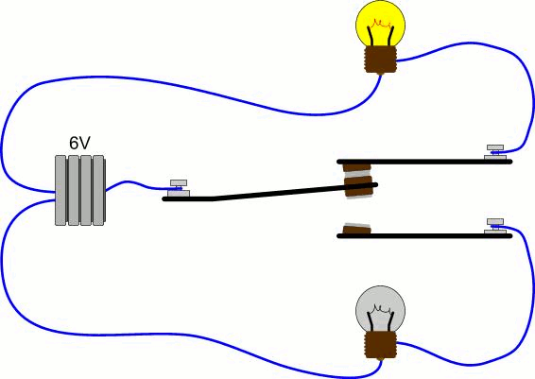
Switches
SPDT
http://pcbheaven.com/wikipages/How_Relays_Work/

Slide 6
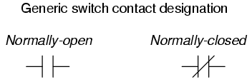
Switches
How is NORMAL determined?
  The normal state of a switch is that where it is unactuated. For process switches, this is the condition its in when sitting on a shelf, uninstalled.
  A switch that is open when unactuated is called normally-open. A switch that is closed when unactuated is called normally-closed. Sometimes the terms “normally-open” and “normally-closed” are abbreviated N.O. and N.C., respectively.
http://www.allaboutcircuits.com/textbook/digital/chpt-4/contact-normal-state-make-break-sequence/

Slide 7
Switch Types (cont)
http://www.musicfromouterspace.com/analogsynth_new/ELECTRONICS/switches.html

Slide 8
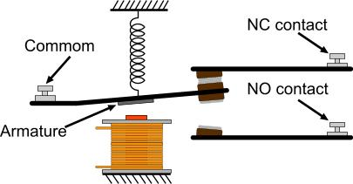
Relay
A Relay is an Electromechanical device that uses an electromagnet to change the status of a switch contact.
http://pcbheaven.com/wikipages/How_Relays_Work/

Slide 9
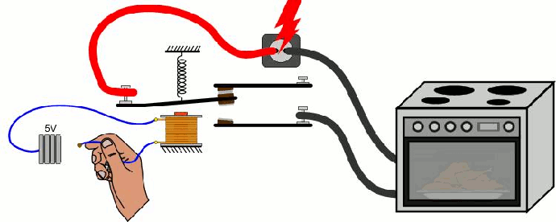
Relay
Example

Slide 10
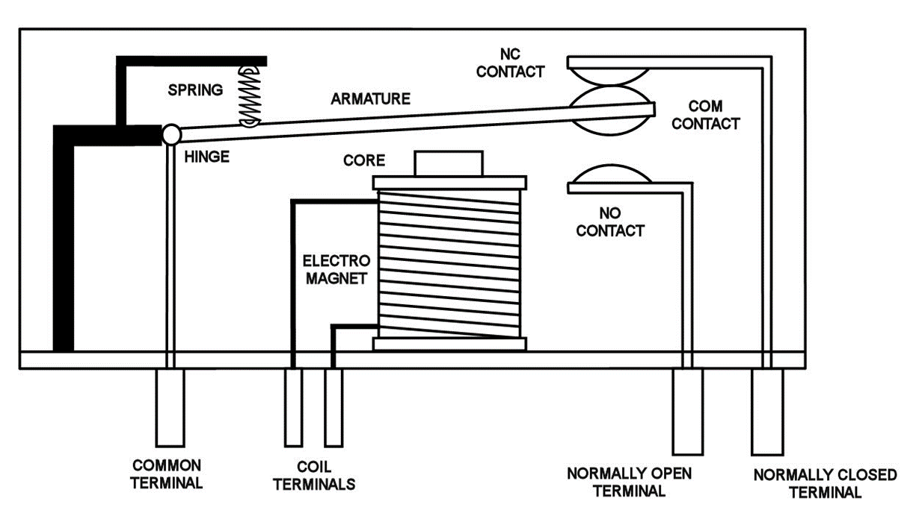
Relay

Slide 11
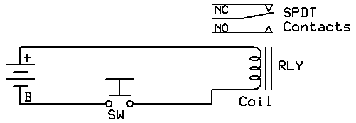
Relay

Slide 12
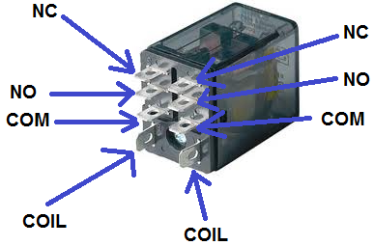
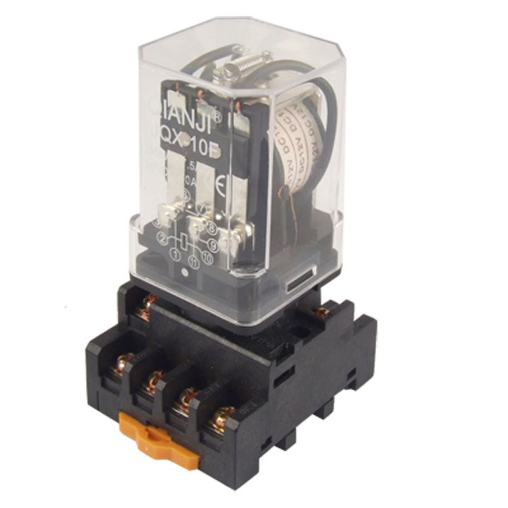
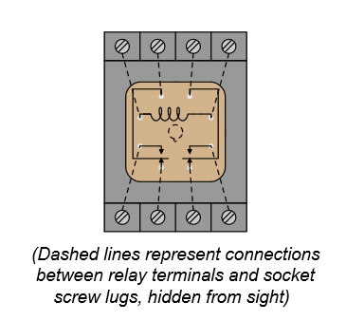
Relay

Slide 13
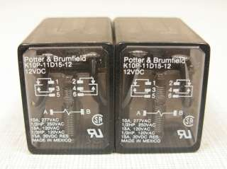
Relay

Slide 14
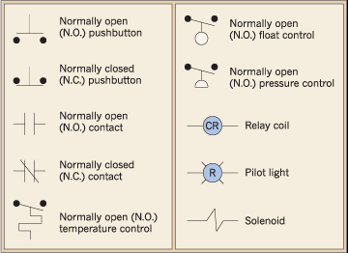
Relay Ladder Logic
Symbols

Slide 15
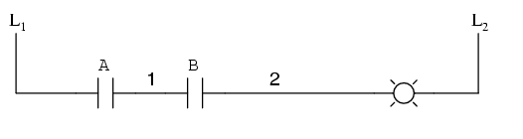
AND

Slide 16
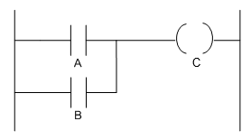
OR

Slide 17
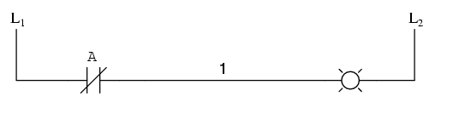
NOT

Slide 18
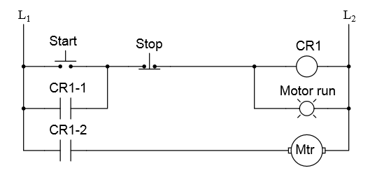
Starter

Slide 19
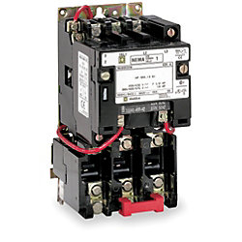
Motor Starter (3 phase)

Slide 20
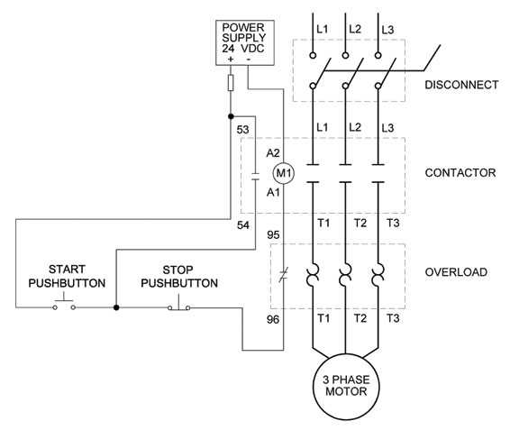
Motor Starter

